Slide 1
Dynamic Memory Allocation

Slide 2
Dynamic Memory Allocation
Can allocate storage for a variable while program is running
Computer returns address of newly allocated variable
Uses new operator to allocate memory:
  double *dptr;
  dptr = new double;
new returns address of memory location

Slide 3
Dynamic Memory Allocation
Can also use new to allocate array:
const int SIZE = 25;
arrayPtr = new double[SIZE];
Can then use [] or pointer arithmetic to access array:
  for(i = 0; i < SIZE; i++)
  *arrayptr[i] = i * i;
  or
  for(i = 0; i < SIZE; i++)
  *(arrayptr + i) = i * i;
Program will terminate if not enough memory available to allocate

Slide 4
Releasing Dynamic Memory
Use delete to free dynamic memory:
  delete fptr;
Use [] to free dynamic array:
  delete [] arrayptr;
Only use delete with dynamic memory!

Slide 5
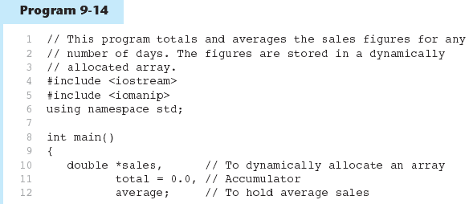

Slide 6
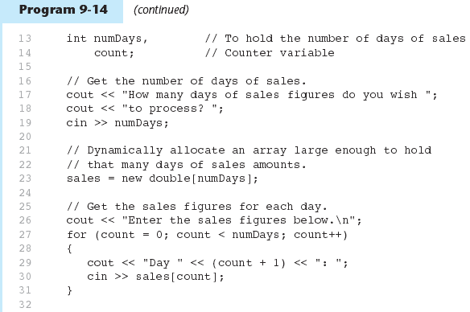

Slide 7
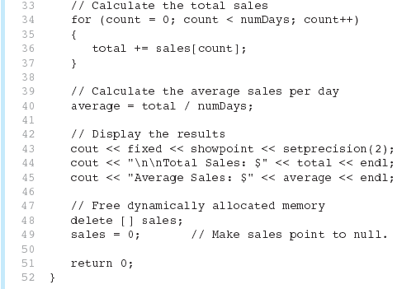
Program 9-14 (Continued)

Slide 8
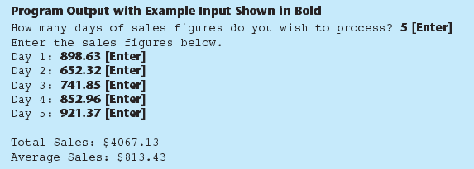
Notice that in line 49 the value 0 is assigned to the sales pointer. It is a good practice to store 0 in a pointer variable after using delete on it. First, it prevents code from inadvertently using the pointer to access the area of memory that was freed. Second, it prevents errors from occurring if delete is accidentally called on the pointer again. The delete operator is designed to have no effect when used on a null pointer.

Slide 9
Returning Pointers from Functions

Slide 10
Returning Pointers from Functions
Pointer can be the return type of a function:
  int* newNum();
The function must not return a pointer to a local variable in the function.
A function should only return a pointer:
  to data that was passed to the function as an argument, or
  to dynamically allocated memory

Slide 11
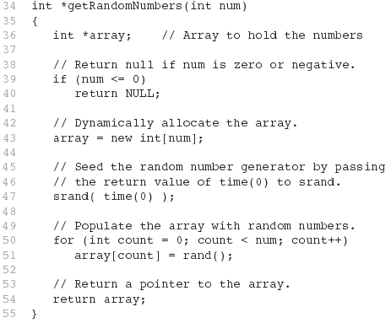
Example

Slide 12
Combining Data into Structures

Slide 13
Combining Data into Structures
Structure: C++ construct that allows multiple variables to be grouped together
General Format:
  struct <structName>
  {
  type1 field1;
  type2 field2;
  . . .
  };

Slide 14
Example struct Declaration
  struct Student
  {
  int studentID;
  string name;
  short yearInSchool;
  double gpa;
  };
structure tag
structure members

Slide 15
struct Declaration Notes
Must have ; after closing }
struct names commonly begin with uppercase letter
Multiple fields of same type can be in comma-separated list:
  string name,
  address;

Slide 16
Defining Variables
struct declaration does not allocate memory or create variables
To define variables, use structure tag as type name:
  Student bill;
bill
studentID
name
yearInSchool
gpa

Slide 17
Accessing Structure Members

Slide 18
Accessing Structure Members
Use the dot (.) operator to refer to members of struct variables:
  cin >> stu1.studentID;
  getline(cin, stu1.name);
  stu1.gpa = 3.75;
Member variables can be used in any manner appropriate for their data type
11-<number>

Slide 19
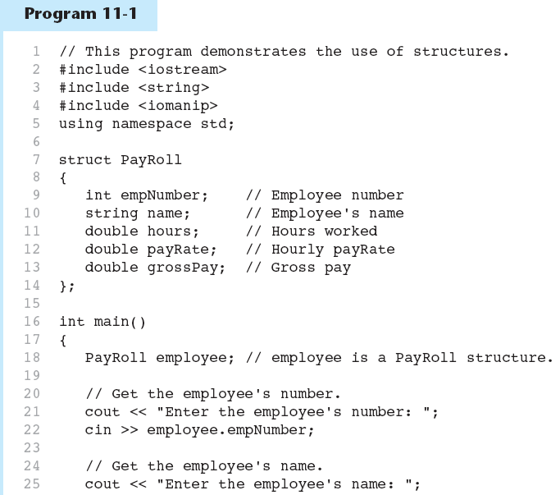

Slide 20
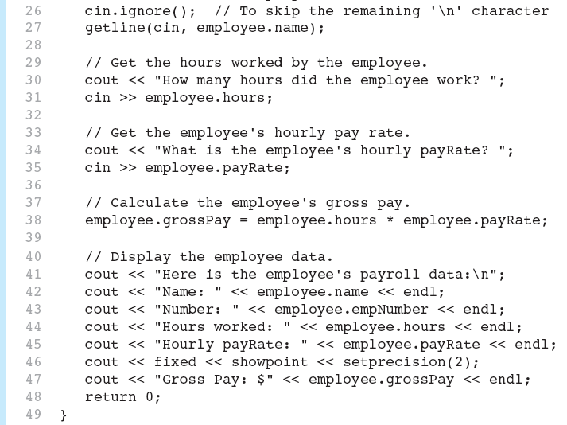

Slide 21
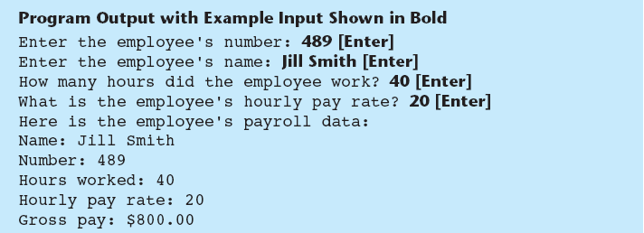

Slide 22
Displaying a struct Variable
To display the contents of a struct variable, must display each field separately, using the dot operator:
  cout << bill; // won’t work
  cout << bill.studentID << endl;
  cout << bill.name << endl;
  cout << bill.yearInSchool;
  cout << " " << bill.gpa;

Slide 23
Comparing struct Variables
Cannot compare struct variables directly:
  if (bill == william) // won’t work
Instead, must compare on a field basis:
  if (bill.studentID ==
  william.studentID) ...

Slide 24
Introduction to the Linked List ADT

Slide 25
Introduction to the Linked List ADT
Linked list: set of data structures (nodes) that contain references to other data structures
NULL
list
head

Slide 26
Introduction to the Linked List ADT
References may be addresses or array indices
Data structures can be added to or removed from the linked list during execution
newNode
list
head
NULL

Slide 27
Linked Lists vs. Arrays and Vectors
Linked lists can grow and shrink as needed, unlike arrays, which have a fixed size
Linked lists can insert a node between other nodes easily
NULL
list
head

Slide 28
Node Organization
A node contains:
  data: one or more data fields – may be organized as structure, object, etc.
  a pointer that can point to another node
pointer
data

Slide 29
Linked List Organization
Linked list contains 0 or more nodes:
Has a list head to point to first node
Last node points to NULL
NULL
list
head

Slide 30
Empty List
If a list currently contains 0 nodes, it is the empty list
In this case the list head points to NULL
list
head
NULL

Slide 31
Declaring a Node
Declare a node:
  struct ListNode
  {
  int data;
  ListNode *next;
  };
No memory is allocated at this time

Slide 32
Defining a Linked List
Define a pointer for the head of the list:
  ListNode *head = NULL;
Head pointer initialized to NULL to indicate an empty list
head
NULL

Slide 33
NULL Pointer
Is used to indicate end-of-list
Should always be tested for before using a pointer:
  ListNode *p;
  while (p != NULL) ...
Can also test the pointer itself:
  while (!p) ... // same meaning
  // as above

Slide 34
Linked List Operations

Slide 35
Linked List Operations
Basic operations:
  append a node to the end of the list
  insert a node within the list
  traverse the linked list
  delete a node
  delete/destroy the list

Slide 36
Contents of NumberList.h
1 // Specification file for the NumberList class
2 #ifndef NUMBERLIST_H
3 #define NUMBERLIST_H
4
5 class NumberList
6 {
7 private:
8 // Declare a structure for the list
9 struct ListNode
10 {
11 double value; // The value in this node
12 struct ListNode *next; // To point to the next node
13 };
14
15 ListNode *head; // List head pointer
16

Slide 37
Contents of NumberList.h (Continued)
17 public:
18 // Constructor
19 NumberList()
20 { head = NULL; }
21
22 // Destructor
23 ~NumberList();
24
25 // Linked list operations
26 void appendNode(double);
27 void insertNode(double);
28 void deleteNode(double);
29 void displayList() const;
30 };
31 #endif

Slide 38
Create a New Node
newNode
Allocate memory for the new node:
  newNode = new ListNode;
Initialize the contents of the node:
  newNode->value = num;
Set the pointer field to NULL:
  newNode->next = NULL;
newNode
23
newNode
23
NULL

Slide 39
Appending a Node
Add a node to the end of the list
Basic process:
  Create the new node (as already described)
  Add node to the end of the list:
    If list is empty, set head pointer to this node
    Else,
      traverse the list to the end
      set pointer of last node to point to new node

Slide 40
Appending a Node
nodePtr
5
13
19
NULL
list
head
23
NULL
newNode
New node created, end of list located

Slide 41
Appending a Node
nodePtr
5
13
19
list
head
23
NULL
newNode
New node added to end of list

Slide 42
Inserting a Node into a Linked List
Used to maintain a linked list in order
Requires two pointers to traverse the list:
  pointer to locate the node with data value greater than that of node to be inserted
  pointer to 'trail behind' one node, to point to node before point of insertion
New node is inserted between the nodes pointed at by these pointers

Slide 43
Inserting a Node into a Linked List
previousNode
nodePtr
5
13
19
NULL
list
head
17
NULL
newNode
New node created, correct position located

Slide 44
Inserting a Node into a Linked List
previousNode
nodePtr
5
13
19
NULL
list
head
17
newNode
New node inserted in order in the linked list

Slide 45
Traversing a Linked List
Visit each node in a linked list: display contents, validate data, etc.
Basic process:
  set a pointer to the contents of the head pointer
  while pointer is not NULL
    process data
    go to the next node by setting the pointer to the pointer field of the current node in the list
  end while

Slide 46
Traversing a Linked List
nodePtr
5
13
19
NULL
list
head
nodePtr points to the node containing 5, then the
node containing 13, then the node containing 19,
then points to NULL, and the list traversal stops

Slide 47
Deleting a Node
Used to remove a node from a linked list
If list uses dynamic memory, then delete node from memory
Requires two pointers: one to locate the node to be deleted, one to point to the node before the node to be deleted

Slide 48
Deleting a Node
previousNode
nodePtr
5
13
19
NULL
list
head
Locating the node containing 13

Slide 49
Deleting a Node
previousNode
nodePtr
5
13
19
NULL
list
head
Adjusting pointer around the node to be deleted

Slide 50
Deleting a Node
previousNode
nodePtr
5
19
NULL
list
head
Linked list after deleting the node containing 13

Slide 51
Destroying a Linked List
Must remove all nodes used in the list
To do this, use list traversal to visit each node
For each node,
  Unlink the node from the list
  If the list uses dynamic memory, then free the node’s memory
Set the list head to NULL

Slide 52
Variations of the
Linked List

Slide 53
Variations of the Linked List
Other linked list organizations:
  doubly-linked list: each node contains two pointers: one to the next node in the list, one to the previous node in the list
5
13
19
NULL
list
head
NULL

Slide 54
Variations of the Linked List
Other linked list organizations:
  circular linked list: the last node in the list points back to the first node in the list, not to NULL
5
13
19
list
head

